Slide 1

Introduction to Pharma
Major Disease Area Overview: Metabolic Disease (Diabetes)
2013

Slide 2
Major disease area overview: Do’s and Don’ts
Do
Don’t
Do go through the training even if you aren’t staffed on a relevant project to build a solid foundation
Do use the material as background information and reference
Do not use the information directly without checking for more recent, updated documents (e.g. journals, treatment guidelines)
Materials are from previous projects which can be out-of-date
Do not copy slides directly for projects, project reports should be customized

Slide 3
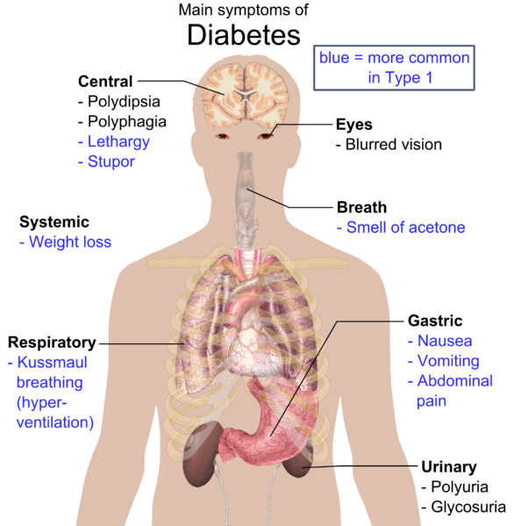
Diabetes is a disease symbolized by high blood sugar with a group of symptoms like loss of weight, polyuria, polydipsia and polyphagia as well as a series of complications in the late stage
Diabetes
Signs and symptoms
Disease definition
Diabetes mellitus, or simply diabetes, is a group of metabolic diseases in which a person has high blood sugar, either because the pancreas does not produce enough insulin, or because cells do not respond to the insulin that is produced.
Signs and symptoms
Classic symptoms: loss of weight, polyuria , polydipsia and polyphagia
Diabetic emergencies: People (usually with type 1 diabetes) may also present with diabetic ketoacidosis
Complications
Acute: Diabetic ketoacidosis, Hyperglycemia hyperosmolar state, Hypoglycemia, Diabetic coma, Respiratory infections, Periodontal disease
Chronic: The damage to small blood vessels leads to a microangiopathy, which can cause one or more of the following diseases such as diabetic cardiomyopathy, diabetic nephropathy etc.
Source: IMS Consulting

Slide 4
Diabetes results from lack of insulin or insulin insensitivity or resistance
Diabetes
Causes and Pathophysiology
Causes
Pathophysiology
Type 1 diabetes is partly inherited, and then triggered by certain infections, with some evidence pointing at Coxsackie B4 virus
Type 2 diabetes is due primarily to lifestyle factors and genetics
Others
Genetic defects of β-cell function
Genetic defects in insulin processing or insulin action
Exocrine pancreatic defects
Endocrinopathies
Infections
Drugs
Insulin is the principal hormone that regulates uptake of glucose from the blood into most cells. Therefore, deficiency of insulin or the insensitivity of its receptors plays a central role in all forms of diabetes mellitus.
If the amount of insulin available is insufficient, if cells respond poorly to the effects of insulin (insulin insensitivity or resistance), or if the insulin itself is defective, then glucose will not have its usual effect, so the net effect is persistent high levels of blood glucose, poor protein synthesis, and other metabolic derangements, such as acidosis
Source: IMS Consulting

Slide 5
It can be mainly categorized into type 1, type 2 and other diabetes
Diabetes
Classification
Causes
Treatment
Progress
Feature
Diabetes types
Type 1 DM
β-cell destruction, usually leading to absolute insulin deficiency
develop quickly
over days or weeks
typically develops in children and young adults
insulin
Type 2 DM
a progressive insulin secretory defect on the background of insulin resistance
develop gradually
over weeks or months
mainly in people aged over 40
OAD +/-
insulin
Other specific types of DM
other causes, e.g., diseases of the exocrine pancreas, etc.
OAD +/-
insulin
NA
NA
Other DM
Gestational diabetes mellitus (GDM)
diagnosed during pregnancy that is not clearly overt diabetes
OAD +/-
insulin
NA
NA
Source: IMS Consulting; Standards of Medical Care in Diabetes in 2013, ADA

Slide 6
Diabetes is diagnosed by a blood test with high glucose level; pre-diabetes is the group of people of increased risk for diabetes
Diabetes
Diagnosis
Diabetes is characterized by recurrent or persistent hyperglycemia, and is diagnosed by demonstrating any one of the following diabetes diagnostic criteria
A positive result, in the absence of unequivocal hyperglycemia, should be confirmed by a repeat of any of the above methods on a different day
Two fasting glucose measurements above 126 mg/dl (7.0 mmol/l) is considered diagnostic for diabetes mellitus
Glycated hemoglobin is better than fasting glucose for determining risks of cardiovascular disease and death from any cause
WHO diabetes diagnostic criteria
Condition | 2 hour glucose (OGTT) | Fasting plasma glucose (FPG) | HbA_{1c}
 | mmol/l(mg/dl) | mmol/l(mg/dl) | %
Normal | <7.8 (<140) | <6.1 (<110) | <6.0
Impaired fasting glycaemia (IFG) | <7.8 (<140) | ≥ 6.1(≥110) & <7.0(<126) | 6.0–6.4
Impaired glucose tolerance (IGT) | ≥7.8 (≥140) & <11.1 | <7.0 (<126) | 6.0–6.4
Diabetes | ≥11.1 (≥200) | ≥7.0 (≥126) | ≥6.5
Pre-daibetes
Diatebes
Pre-diabetes is the state in which some but not all of the diagnostic criteria for diabetes are met
It’s the categories of increased risk for diabetes
Impaired fasting glycaemia or impaired fasting glucose (IFG) refers to a condition in which the fasting blood glucose is elevated above normal but is not high enough to be classified as diabetes
Impaired glucose tolerance (IGT) is a pre-diabetic state of dysglycemia, that is associated with insulin resistance and increased risk of cardiovascular pathology. IGT may precede type 2 diabetes mellitus by many years
Source: IMS Consulting

Slide 7
Diabetes management not only includes medications but also requires lifestyle changes and support from general practitioners
Diabetes
Treatment
Diabetes management
Diabetes Care
Aims of diabetes treatment
Keep blood glucose level at normal levels
Reduce other risk factors
Detect and treat any complications promptly
Diet, weight control and physical activity to keep blood glucose levels within acceptable bounds
Control blood pressure for those with higher risks of CV diseases
Self management information service
Dietary/ Nutrition
Lifestyle
Co- morbidity treatment
Preventive Therapy
There are various OAD that can reduce the blood glucose level, a combination of medicines is commonly seen
Insulin is needed if the above treatments do not work well. Type 1 diabetes is typically treated with insulin
Glucose Control
Medications
Diagnosis/ Prognosis
Support
Medical Nutrition Therapy (MNT) and Diabetes Self- Management Training (DSMT) with regular ongoing blood glucose level monitoring provided by general practitioners
Diabetes Treatment
Source: IMS Consulting

Slide 8
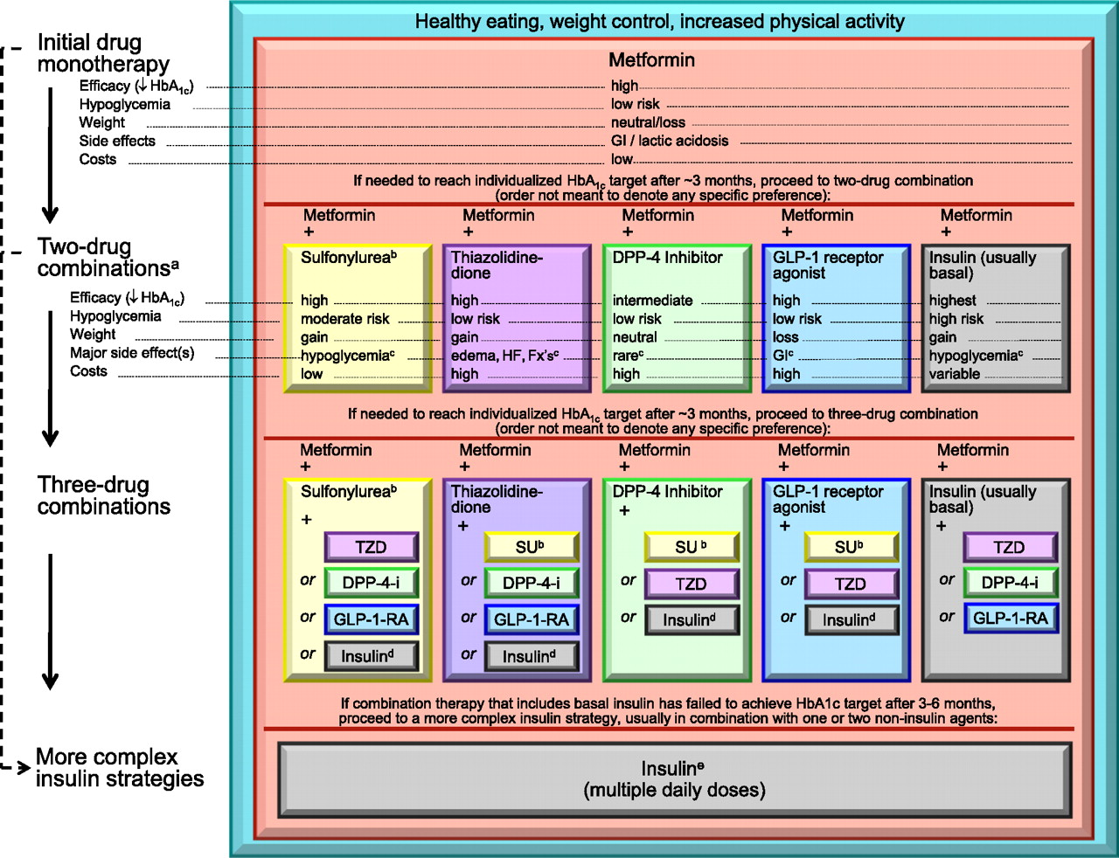
A variety of medications are available in the market and in the pipeline
Diabetes
Medication
Insulin
A-Gluco.INH
Classic class
Sulfonamide (SU)
Thiazolidine-dione (TZD)
Glinide
GLP-1
Launched New & future class
DPP IV
SGLT-2
Source: IMS Consulting; Standards of Medical Care in Diabetes—2013, ADA

Slide 9
Novo Nordisk is the key player in China’s insulin market, the market reached 9.3 Bn in 2012
Diabetes
Insulin Market Size
(2008-2012, Mn RMB)
Rank | Mnf. | Prod. | Mole. | Indication
1 | NOVO NORDISK | NOVO-LIN 30R | INSULIN HUMAN (BASE/ISOPHANE) | Diabetes
2 | NOVO NORDISK | NOVO-MIX 30 | INSULIN ASPART PROTAMINE CRYSTALLINE | Generally must be injected before dinner. When necessary, can be given immediately after a meal.
3 | AVENTIS | LANTUS | INSULIN GLARGINE | Diabetes
4 | NOVO NORDISK | NOVO-LIN 50R | INSULIN HUMAN (BASE/ISOPHANE) | Diabetes
5 | ELI LILLY | HUMU-LIN 70/30 | INSULIN HUMAN (BASE/ISOPHANE) | Suitable for patients who need insulin to maintain normal blood glucose level, also can be applied to patients in early stage or during pregnancy
Sales Value
10,000
9,339
9,000
594
HUMULIN 70/30
8,000
+24%
672
NOVOLIN 50R
911
LANTUS
7,000
6,512
6,000
513
2,147
NOVOMIX 30
515
5,000
549
4,000
3,979
1,113
399
2,195
NOVOLIN 30R
3,000
392
208
299
2,078
2,000
1,577
1,000
2,821
Other insulin
1,103
1,744
0
2008
2010
2012
Source: CHPA, IMS analysis

Slide 10
OAD market reached 6.6 bn RMB in 2012, Glucobay from Bayer is the #1 product
Diabetes
OAD Market Size
(2008-2012, Mn RMB)
Rank | Mnf | Product | Molecule | Indication
1 | BAYER | GLUCO-BAY | ACARBOSE | Applicable to high glucose after meals
2 | NOVO-NORDISK | NOVO-NORM | REPAGLI-NIDE | T2D with non insulin dependent
3 | SQUIBB | GLUCO-PHAGE | METFORMIN | As preferred choice for T2D with obesity
4 | AVENTIS | AMARYL | GLIMEPIRIDE | Non insulin dependent diabetes with normal weight
5 | HUA-DONG | KA BO PING | ACARBOSE | Applicable to high glucose after meals
Sales Value
7,000
6,592
6,500
346
KA BO PING
6,000
+21%
367
AMARYL
5,500
509
GLUCOPHAGE
5,000
4,742
740
NOVONORM
4,500
232
202
4,000
347
3,500
600
1,676
GLUCOBAY
3,050
3,000
169
92
1,275
2,500
330
207
2,000
814
1,500
2,954
Others OAD
1,000
2,085
500
1,439
0
2008
2010
2012
Source: CHPA, IMS analysis

Slide 11
China diabetes population has reached ~90Mn currently
Diabetes
Epidemiology
Please check and update data for project work
Adults (20 years of age or older) in China
(952.6 Mn)
Prevalence: 9.7%¹
Prevalence: 15.5%¹
Adults with Diabetes
(92.4 Mn)
Adults with Pre-diabetes
(148.2 Mn)
Diagnosis: 39.7%¹
Diagnostic Adults with Type 2 Diabetes
(36.7 Mn)
93.7%²
0.7%²
Type 1 Diabetic patients
(2.0~3.0 Mn⁵)
Diagnosed Type 2 Diabetes
(34.4 Mn)
Diagnosed Other Diabetes
(0.2 Mn)
Treatment: 95%⁴
Treatment: 40%²
Treated Type 1 Diabetes
(2.0~2.8 Mn)
Treated Type 2 Diabetes
(13.8 Mn)
20%³
100%³
80%³
Insulin
(2.0~2.8 Mn)
Western Medicine
(11.0 Mn)
TCM & Other Health Products
(2.8 Mn)
Note:
Type 1 diabetes has significant symptoms which will be diagnosed easily²
20%³
30%³
50%³
Insulin
(2.2 Mn)
OAD + Insulin
(3.3 Mn)
OAD
(5.5 Mn)
1. Prevalence of Diabetes among Men and Women in China. NEJM, v362, n12, March 2010
2. China Diabetes Treatment Guideline
3.4. IMS Primary Market Research and IMS analysis
Source: IMS past project experience

Slide 12
The diabetes market is rapidly growing in China propelled by ever increasing patient base and attention from drug manufacturers and government
Diabetes
Market trend
Diabetes market will grow rapidly in the next few years, attracting much attention from government, association and manufacturers
Rapid growth of diabetes patients to reach even higher prevalence
Faster diabetes patients growth in rural area
More younger people will become diabetic
Fast growth of the patient pool stimulates new drug launches and popularization of new disease monitoring method
New MOA drug launches are expected, however, classic treatment will remain important
HbA1c would become a complementary measurement tool
Such fast growth and large patient population also draw increasing attention from government on public education, primary care infrastructure building as well as disease screening and management
Continue basic health care service
Train primary care physician: patients will go to CHCs mainly
Conduct research on primary care management approach
Educate the public
Build up central & western China primary care infrastructure
Source: IMS past project experience

